Slide 1


Group Project
Node 4

Slide 2


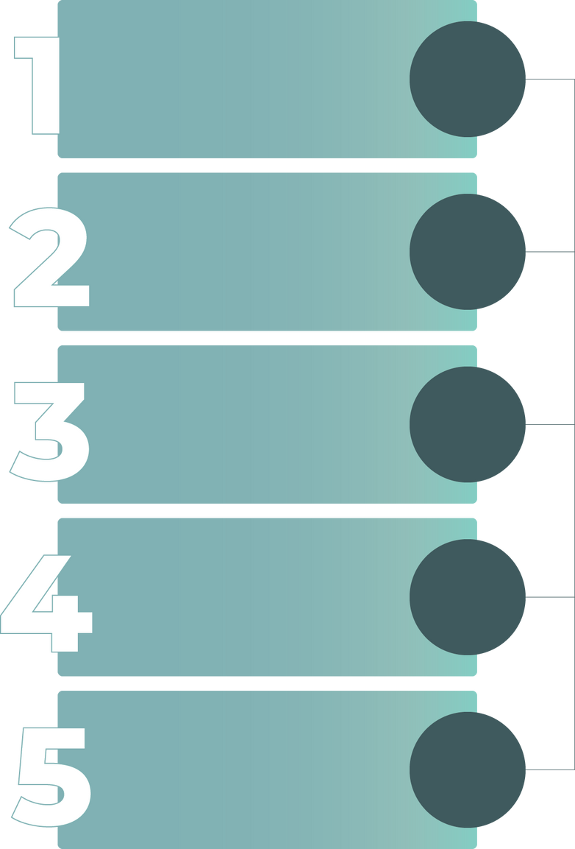
Overview
1.
5.
Our Team
Save & Load
2.
6.
Introduction
Error Handling
3.
7.
Code Structure
Demo
4.
8.
Functions
Conclusion

Slide 3
Our Team :
Hamdi Emad
Mohamed Kadry
Sara Hussien
Ahmed Mahmoud

Slide 4



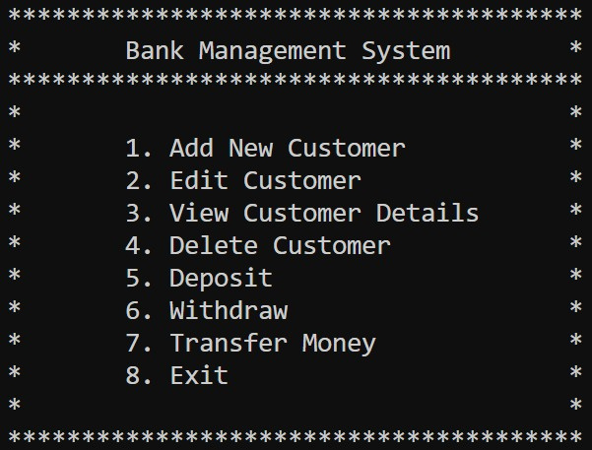
Introduction :
Bank Customer Management System is a console-based bank management system designed to handle and organize customer data in a simplified banking environment.

Slide 5
Code Structure :
our project has these files:
main.c → shows the menu and handles user input.
functions.c → contains all the features (add, edit, transfer...).
functions.h → defines the customer and all function headers.
customers.txt → saves customer data permanently.

Slide 6
1
Create customer
2
Edit customer
3
Find customer
Main Functions
4
Print customer data
5
Delete customer
6
6
Transfer money
7
Deposit / Withdraw

Slide 7

Main Functions :
Create customer
Edit customer
Adds a new customer by collecting their name, phone number, and initial balance. Assigns a unique ID and stores the customer in the system.
Allows updating an existing customer's details (name, phone, or balance) by entering their ID.
print customer data
delete customer
Removes a customer from the system by ID. It shifts the array to maintain correct indexing.
Displays customer information (ID, name, phone, balance) by searching with their ID.

Slide 8
Main Functions :
Find customer
transfer money
Searches for a customer by ID and returns their index in the array (used internally in other functions).
Transfers money from one customer to another by using both IDs. Checks if sender has enough balance.
deposit
withdraw
Increases a customer’s account balance by a specified amount after verifying the ID.
Decreases a customer’s balance after checking sufficient funds and valid ID.

Slide 9
Save Data
Load Data
Purpose:
To store all customer records permanently by writing them to a file (customers.txt).
How it works:
Opens the file in write mode using fopen("customers.txt", "w").
Loops through the customers array.
For each customer, it writes their details (ID, name, phone, balance) using fprintf() in formatted text form
Purpose:
To read previously saved customer data from the file into memory when the program starts.
How it works:
Opens the file in read mode using fopen("customers.txt", "r").
Reads each line using fscanf() and fills the customers array with the loaded data.

Slide 10
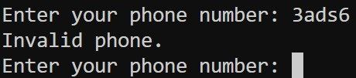
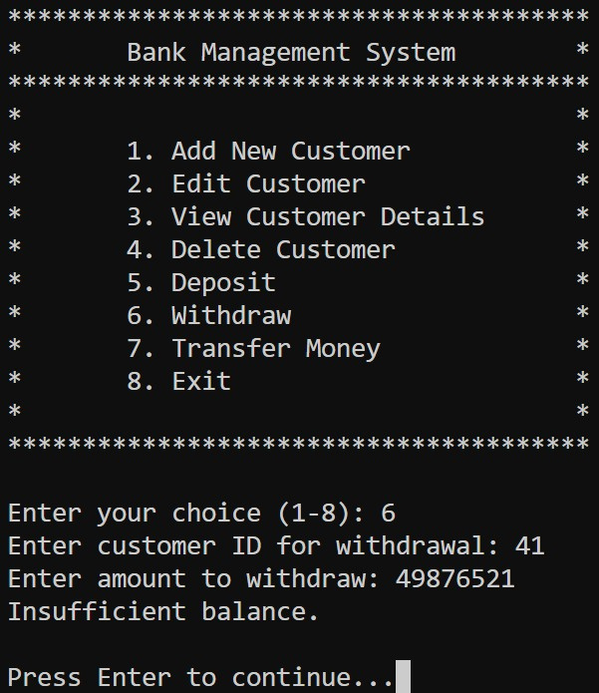
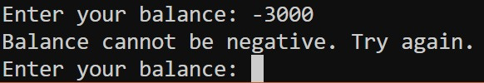
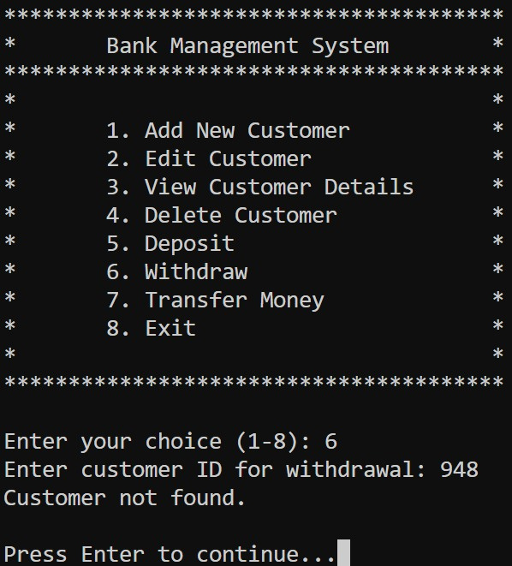
Error Handling :
To make the system user-friendly and avoid crashes or incorrect operations, we implemented proper error handling:
No negative balance allowed
Customer must exist
Sufficient balance check before withdrawal/transfer
Invalid ID input

Slide 11
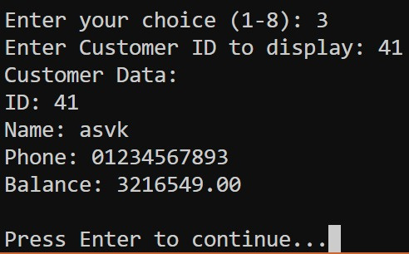
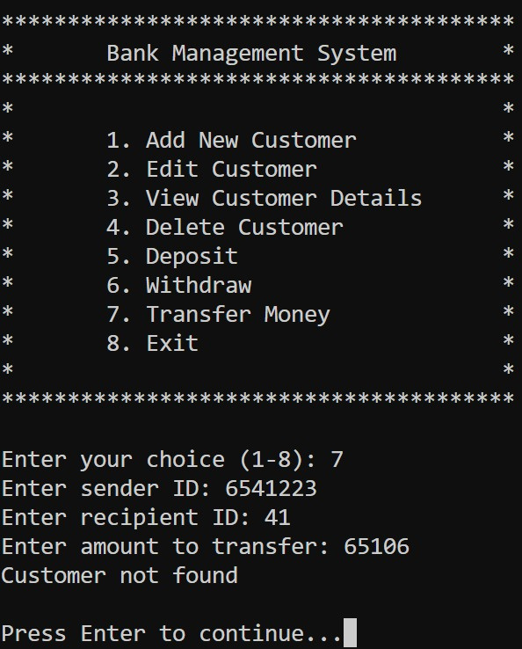
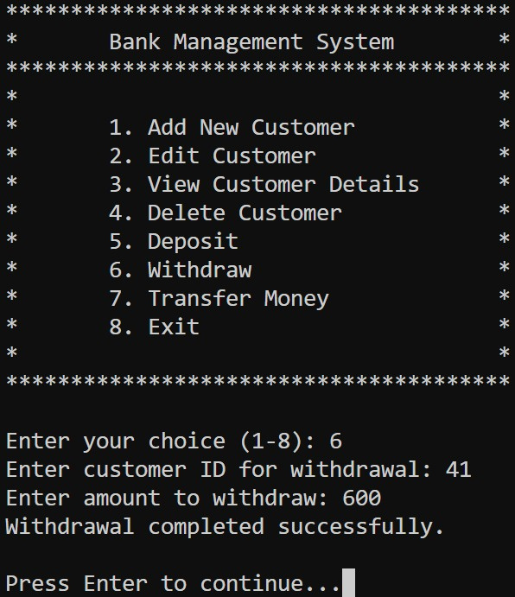

Slide 12
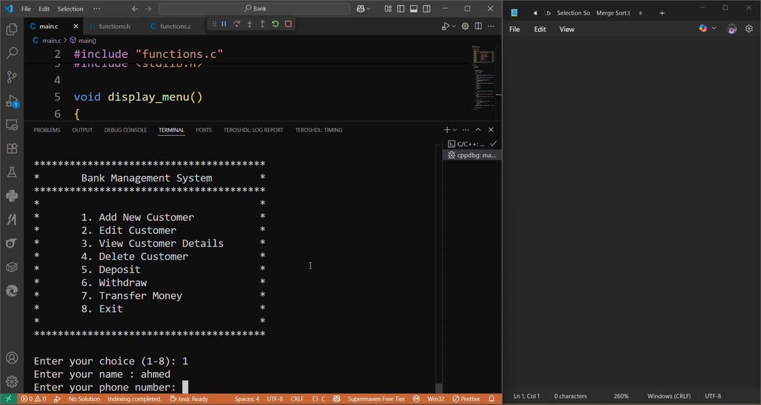
Demo :

Slide 13
Thank
You

